Slide 1
UNIT-4 Spring Boot

Slide 2
Introduction
Spring Boot is a project that is built on the top of the Spring Framework.
It provides an easier and faster way to set up, configure, and run both simple and web-based applications.
It is a Spring module that provides the RAD (Rapid Application Development) feature to the Spring Framework.
It is used to create a stand-alone Spring-based application that you can just run because it needs minimal Spring configuration.

Slide 3
Spring vs Spring Boot
Spring: Spring Framework is the most popular application development framework of Java. The main feature of the Spring Framework is dependency Injection or Inversion of Control (IoC). With the help of Spring Framework, we can develop a loosely coupled application. It is better to use if application type or characteristics are purely defined.
Spring Boot: Spring Boot is a module of Spring Framework. It allows us to build a stand-alone application with minimal or zero configurations. It is better to use if we want to develop a stand alone Spring-based application or RESTful services.

Slide 4
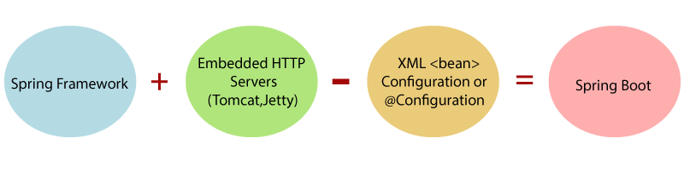
In short, Spring Boot is the combination of Spring Framework and Embedded Servers.
In Spring Boot, there is no requirement for XML configuration (deployment descriptor). It uses convention over configuration software design paradigm that means it decreases the effort of the developer.

Slide 5
Spring Boot Framework Uses
The dependency injection approach is used in Spring Boot.
It contains powerful database transaction management capabilities.
It simplifies integration with other Java frameworks like JPA/Hibernate ORM, Struts, etc.
It reduces the cost and development time of the application.

Slide 6
Spring Boot Architecture
Spring Boot is a module of the Spring Framework. It is used to create stand-alone, production-grade Spring Based Applications with minimum efforts. It is developed on top of the core Spring Framework.
Spring Boot follows a layered architecture in which each layer communicates with the layer directly below or above (hierarchical structure) it.
Before understanding the Spring Boot Architecture, we must know the different layers and classes present in it. There are four layers in Spring Boot are as follows:
Presentation Layer
Business Layer
Persistence Layer
Database Layer

Slide 7
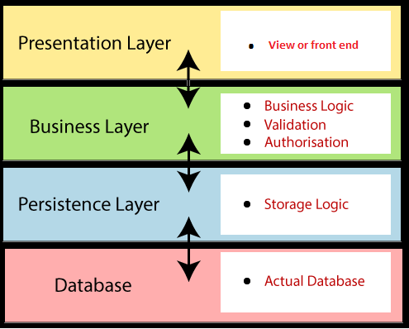

Slide 8
Presentation Layer: The presentation layer handles the HTTP requests, translates the JSON parameter to object, and authenticates the request and transfer it to the business layer. In short, it consists of views i.e., frontend part.
Business Layer: The business layer handles all the business logic. It consists of service classes and uses services provided by data access layers. It also performs authorization and validation.
Persistence Layer: The persistence layer contains all the storage logic and translates business objects from and to database rows.
Database Layer: In the database layer, CRUD (create, retrieve, update, delete) operations are performed.

Slide 9
Spring Boot Softwares
Java 1.8
Maven 3.0+
An IDE (IntelliJ) is recommended.

Slide 10
First Project
Open IntelliJ IDEA 2020.3.Navigate to File -> New -> Project
Then choose maven tab and set
Group: com.example
Artifact: welcome-springboot
Then click Finish
Once the project is created, navigate to the src/main/java/com/example/welcome directory. Create the WelcomeSpringbootApplication.java
Create the pom.xml file in the root directory of your project. Ensure it includes the necessary Spring Boot dependencies:

Slide 11
Example1

Slide 12
WelcomeSpringbootApplication.java
package com.example.welcome;
import org.springframework.boot.SpringApplication;
import org.springframework.boot.autoconfigure.SpringBootApplication;
import org.springframework.web.bind.annotation.GetMapping;
import org.springframework.web.bind.annotation.RestController;
@SpringBootApplication
@RestController
public class WelcomeSpringbootApplication {
public static void main(String[] args) {
SpringApplication.run(WelcomeSpringbootApplication.class, args);
}
@GetMapping("/")
public String welcomeMessage() {
return "Welcome to Spring Boot";
}
}

Slide 13
Pom.xml
<dependencies>
<dependency>
<groupId>org.springframework.boot</groupId>
<artifactId>spring-boot-starter-web</artifactId>
</dependency>
<dependency>
<groupId>org.springframework.boot</groupId>
<artifactId>spring-boot-starter-thymeleaf</artifactId>
</dependency>
</dependencies>
<build>
<plugins>
<plugin>
<groupId>org.springframework.boot</groupId>
<artifactId>spring-boot-maven-plugin</artifactId>
</plugin>
</plugins>
</build>
</project>
<project xmlns="http://maven.apache.org/POM/4.0.0"
xmlns:xsi="http://www.w3.org/2001/XMLSchema-instance"
xsi:schemaLocation="http://maven.apache.org/POM/4.0.0
http://maven.apache.org/xsd/maven-4.0.0.xsd">
<modelVersion>4.0.0</modelVersion>
<groupId>com.example</groupId>
<artifactId>welcomeproject</artifactId>
<version>1.0.0</version>
<packaging>jar</packaging>
<parent>
<groupId>org.springframework.boot</groupId>
<artifactId>spring-boot-starter-parent</artifactId>
<version>2.3.0.RELEASE</version>
</parent>

Slide 14
Output:
Welcome to Spring Boot

Slide 15
@SpringBootApplication: Marks this class as the entry point for the Spring Boot application.
@RestController: Enables RESTful web services.
@GetMapping("/"): Maps the root URL (/) to the welcomeMessage() method.

Slide 16
Annotations
Annotations in Spring Boot are special forms of metadata that provide instructions or behavior to the framework. They simplify and reduce boilerplate code by allowing the developer to define functionality using declarative programming. Spring Boot uses a wide variety of annotations to manage beans, handle HTTP requests, define configuration, etc.

Slide 17
@SpringBootApplication
@SpringBootApplication is a meta-annotation that combines three important Spring annotations:
@SpringBootConfiguration
@EnableAutoConfiguration
@ComponentScan
It is placed on the main class of a Spring Boot application and acts as the entry point for the application. When this annotation is used, Spring Boot will automatically configure your application based on the dependencies added to your project and scan for components (beans) in the package where this class is located.
Ex:
@SpringBootApplication
public class MySpringBootApp {
public static void main(String[] args) {
SpringApplication.run(MySpringBootApp.class, args);
}
}

Slide 18
@RestController
@RestController is a specialized version of the @Controller annotation. It is used in Spring to define a controller that handles HTTP requests and returns data directly as the response body rather than rendering a view.
@RestController is a combination of:
@Controller: Marks the class as a web controller.
@ResponseBody: Indicates that the return value of the methods in this controller should be written directly to the HTTP response body, usually in JSON or XML format.
@Controller is used to define a regular Spring MVC controller. Unlike @RestController, it is typically used when you want to return a view (e.g., JSP, Thymeleaf) instead of sending the response body directly.
Ex:
@RestController
public class MyRestController {
@GetMapping("/welcome")
public String welcomeMessage() {
return "Welcome to Spring Boot!";
}
}

Slide 19
@GetMapping
@GetMapping is a specialized annotation in Spring that handles HTTP GET requests. It is a shorthand for @RequestMapping(method = RequestMethod.GET) and is used to map HTTP GET requests to specific handler methods in a controller.
It simplifies the mapping of URLs to methods that should be invoked when an HTTP GET request is received.
Ex:
@RestController
public class MyController {
@GetMapping("/greet")
public String greet() {
return "Hello, World!";
}
}

Slide 20
Pom.xml
<dependencies>
<dependency>
<groupId>org.springframework.boot</groupId>
<artifactId>spring-boot-starter-web</artifactId>
</dependency>
<dependency>
<groupId>org.springframework.boot</groupId>
<artifactId>spring-boot-starter-thymeleaf</artifactId>
</dependency>
</dependencies>
<build>
<plugins>
<plugin>
<groupId>org.springframework.boot</groupId>
<artifactId>spring-boot-maven-plugin</artifactId>
</plugin>
</plugins>
</build>
</project>
<project xmlns="http://maven.apache.org/POM/4.0.0"
xmlns:xsi="http://www.w3.org/2001/XMLSchema-instance"
xsi:schemaLocation="http://maven.apache.org/POM/4.0.0
http://maven.apache.org/xsd/maven-4.0.0.xsd">
<modelVersion>4.0.0</modelVersion>
<groupId>com.example</groupId>
<artifactId>springboot-addition</artifactId>
<version>1.0.0</version>
<packaging>jar</packaging>
<parent>
<groupId>org.springframework.boot</groupId>
<artifactId>spring-boot-starter-parent</artifactId>
<version>2.3.0.RELEASE</version>
</parent>

Slide 21
Pom.xml
The pom.xml (Project Object Model) file is a core part of a Maven project and serves as the configuration file for Maven-based projects. It defines the project's dependencies, plugins, goals, build configuration, and other settings.
When you run Maven commands, Maven refers to the pom.xml to know how to build the project and what dependencies and plugins it needs.
Functions of pom.xml:
Dependency Management: Automatically handles libraries and their versions.
Build Configuration: Defines how the project is compiled, packaged, and deployed.
Project Metadata: Holds information about the project and versioning.
Plugins: Enhances the build process with specific tasks like running tests, generating reports, or packaging the application.

Slide 22
Key Elements of pom.xml
Project Metadata: Defines essential project information such as the group ID, artifact ID, version, and packaging type.
<groupId>com.example</groupId> <!-- Unique identifier for the project -->
<artifactId>my-app</artifactId> <!-- The name of the project -->
<version>1.0.0</version> <!-- The version of the project -->
<packaging>jar</packaging> <!-- Type of packaging: jar, war, etc. -->

Slide 23
Dependencies: Lists all the external libraries (dependencies) that the project needs to compile and run. Maven automatically downloads these libraries from remote repositories.
<dependencies>
<dependency>
<groupId>org.springframework.boot</groupId>
<artifactId>spring-boot-starter-web</artifactId>
<version>2.4.2</version>
</dependency>
<dependency>
<groupId>org.springframework.boot</groupId>
<artifactId>spring-boot-starter-thymeleaf</artifactId>
<version>2.4.2</version>
</dependency>
</dependencies>

Slide 24
Parent Project: If your project is based on another project (like Spring Boot), the parent section can inherit certain configurations from that parent project. Spring Boot projects typically inherit from spring-boot-starter-parent.
<parent>
<groupId>org.springframework.boot</groupId>
<artifactId>spring-boot-starter-parent</artifactId>
<version>2.4.2</version>
</parent>

Slide 25
Plugins: Defines Maven plugins that provide additional functionalities during the build process, such as compiling Java code, packaging, testing, etc.
<build>
<plugins>
<plugin>
<groupId>org.springframework.boot</groupId>
<artifactId>spring-boot-maven-plugin</artifactId>
</plugin>
</plugins>
</build>

Slide 26
Example2
To explain the use of @Controller

Slide 27
WelcomeSpringbootApplication.java
package com.example.welcome;
import org.springframework.boot.SpringApplication;
import org.springframework.boot.autoconfigure.SpringBootApplication;
import org.springframework.web.bind.annotation.GetMapping;
import org.springframework.stereotype.Controller;
import org.springframework.web.bind.annotation.GetMapping;
import org.springframework.web.bind.annotation.RestController;
@SpringBootApplication
@Controller
public class WelcomeSpringbootApplication {
public static void main(String[] args) {
SpringApplication.run(WelcomeSpringbootApplication.class, args);
}
@GetMapping("/")
public String welcomeMessage() {
return "welcome";
}
}

Slide 28
Welcome.html
<html>
<head>
<title>Welcome Page</title>
</head>
<body>
<h1>Welcome to Spring Boot!</h1>
<p>This is a web page</p>
</body>
</html>

Slide 29
Pom.xml
<dependencies>
<dependency>
<groupId>org.springframework.boot</groupId>
<artifactId>spring-boot-starter-web</artifactId>
</dependency>
<dependency>
<groupId>org.springframework.boot</groupId>
<artifactId>spring-boot-starter-thymeleaf</artifactId>
</dependency>
</dependencies>
<build>
<plugins>
<plugin>
<groupId>org.springframework.boot</groupId>
<artifactId>spring-boot-maven-plugin</artifactId>
</plugin>
</plugins>
</build>
</project>
<project xmlns="http://maven.apache.org/POM/4.0.0"
xmlns:xsi="http://www.w3.org/2001/XMLSchema-instance"
xsi:schemaLocation="http://maven.apache.org/POM/4.0.0
http://maven.apache.org/xsd/maven-4.0.0.xsd">
<modelVersion>4.0.0</modelVersion>
<groupId>com.example</groupId>
<artifactId>welcomeproject</artifactId>
<version>1.0.0</version>
<packaging>jar</packaging>
<parent>
<groupId>org.springframework.boot</groupId>
<artifactId>spring-boot-starter-parent</artifactId>
<version>2.3.0.RELEASE</version>
</parent>

Slide 30
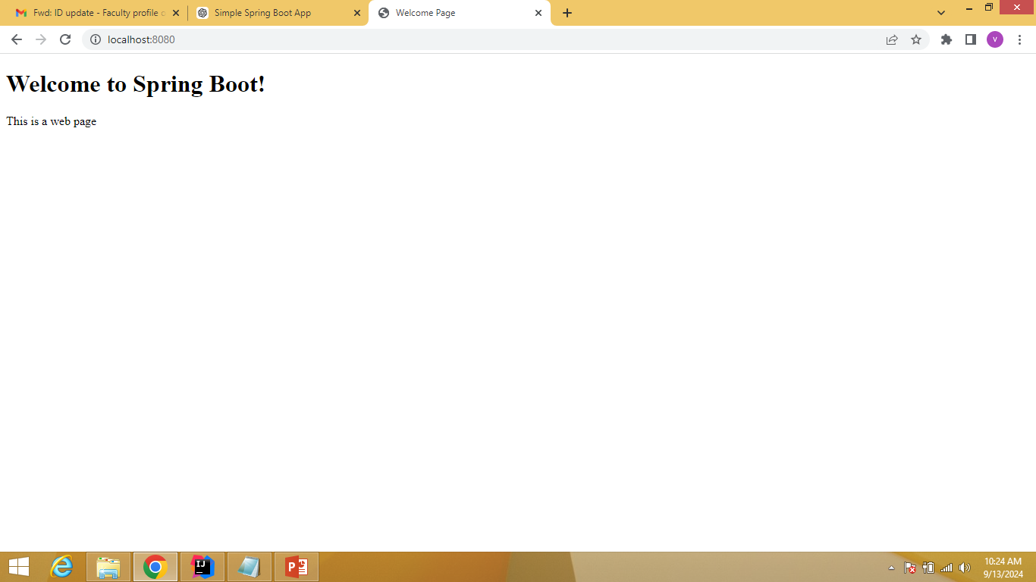

Slide 31
Example3
To explain the use of GetMapping with the input string
@GetMapping("/print")

Slide 32
WelcomeSpringbootApplication.java
package com.example.welcome;
import org.springframework.boot.SpringApplication;
import org.springframework.boot.autoconfigure.SpringBootApplication;
import org.springframework.web.bind.annotation.GetMapping;
import org.springframework.web.bind.annotation.RestController;
@SpringBootApplication
@RestController
public class WelcomeSpringbootApplication {
public static void main(String[] args) {
SpringApplication.run(WelcomeSpringbootApplication.class, args);
}
@GetMapping("/print")
public String welcomeMessage() {
return "Welcome to Spring Boot";
}
}

Slide 33
Pom.xml
<dependencies>
<dependency>
<groupId>org.springframework.boot</groupId>
<artifactId>spring-boot-starter-web</artifactId>
</dependency>
<dependency>
<groupId>org.springframework.boot</groupId>
<artifactId>spring-boot-starter-thymeleaf</artifactId>
</dependency>
</dependencies>
<build>
<plugins>
<plugin>
<groupId>org.springframework.boot</groupId>
<artifactId>spring-boot-maven-plugin</artifactId>
</plugin>
</plugins>
</build>
</project>
<project xmlns="http://maven.apache.org/POM/4.0.0"
xmlns:xsi="http://www.w3.org/2001/XMLSchema-instance"
xsi:schemaLocation="http://maven.apache.org/POM/4.0.0
http://maven.apache.org/xsd/maven-4.0.0.xsd">
<modelVersion>4.0.0</modelVersion>
<groupId>com.example</groupId>
<artifactId>welcomeproject</artifactId>
<version>1.0.0</version>
<packaging>jar</packaging>
<parent>
<groupId>org.springframework.boot</groupId>
<artifactId>spring-boot-starter-parent</artifactId>
<version>2.3.0.RELEASE</version>
</parent>

Slide 34
Output:
http:/localhost:8080/print
Welcome to Spring Boot

Slide 35
Example4
Spring boot application to display the square of the given number by the user

Slide 36
WelcomeSpringbootApplication.java
package com.example.springbootaddition;
import org.springframework.boot.SpringApplication;
import org.springframework.boot.autoconfigure.SpringBootApplication;
@SpringBootApplication
public class SpringBootApplication {
public static void main(String[] args) {
SpringApplication.run(SpringBootAdditionApplication.class, args);
}
}

Slide 37
squareController.java
package com.example.springbootaddition;
import org.springframework.stereotype.Controller;
import org.springframework.ui.Model;
import org.springframework.web.bind.annotation.GetMapping;
import org.springframework.web.bind.annotation.PostMapping;
import org.springframework.web.bind.annotation.RequestParam;
@Controller
public class squareController {
@GetMapping("/")
public String showForm() {
return "num";
}
@PostMapping("/square")
public String squareNumbers(@RequestParam("num1") int num1,
Model model) {
int square = num1*num1;
model.addAttribute("square", square);
return "result";
}
}

Slide 38
num.html
<!DOCTYPE html>
<html xmlns:th="http://www.thymeleaf.org">
<head>
<title>Squaring the Numbers</title>
</head>
<body>
<h1>Squaring the Number</h1>
<form action="/square" method="post">
<label for="num1">Number 1:</label>
<input type="text" id="num1" name="num1"><br>
<input type="submit" value="square">
</form>
</body>
</html>

Slide 39
result.html
<!DOCTYPE html>
<html xmlns:th="http://www.thymeleaf.org">
<head>
<title>Result</title>
</head>
<body>
<h1>Result</h1>
<p>The square is: <span th:text="${square}"></span></p>
<a href="/">Square other numbers</a>
</body>
</html>

Slide 40
Pom.xml
<dependencies>
<dependency>
<groupId>org.springframework.boot</groupId>
<artifactId>spring-boot-starter-web</artifactId>
</dependency>
<dependency>
<groupId>org.springframework.boot</groupId>
<artifactId>spring-boot-starter-thymeleaf</artifactId>
</dependency>
</dependencies>
<build>
<plugins>
<plugin>
<groupId>org.springframework.boot</groupId>
<artifactId>spring-boot-maven-plugin</artifactId>
</plugin>
</plugins>
</build>
</project>
<project xmlns="http://maven.apache.org/POM/4.0.0"
xmlns:xsi="http://www.w3.org/2001/XMLSchema-instance"
xsi:schemaLocation="http://maven.apache.org/POM/4.0.0
http://maven.apache.org/xsd/maven-4.0.0.xsd">
<modelVersion>4.0.0</modelVersion>
<groupId>com.example</groupId>
<artifactId>welcomeproject</artifactId>
<version>1.0.0</version>
<packaging>jar</packaging>
<parent>
<groupId>org.springframework.boot</groupId>
<artifactId>spring-boot-starter-parent</artifactId>
<version>2.3.0.RELEASE</version>
</parent>

Slide 41
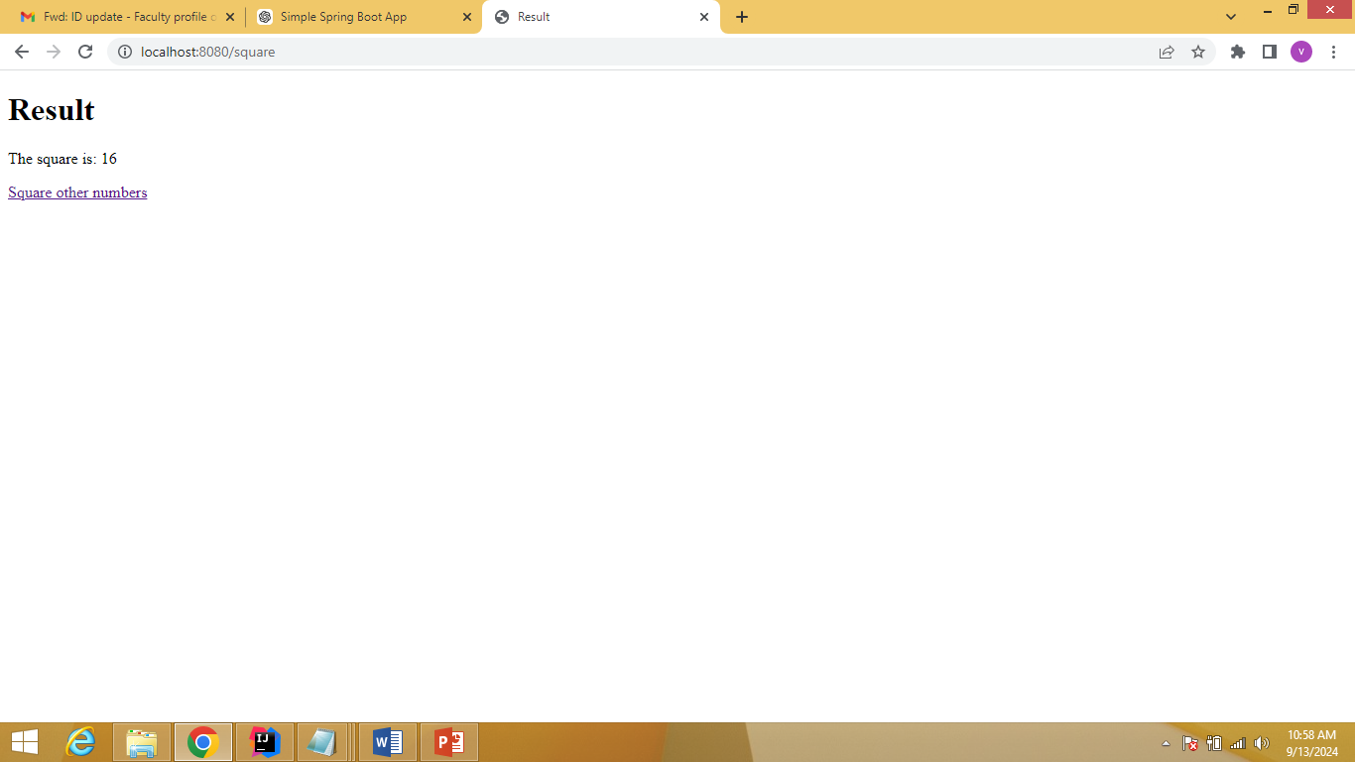

Slide 42
Example 5
Practice the Spring boot web app for addition and subtraction of two numbers

Slide 43
SpringBootAdditionApplication.java
package com.example.springbootaddition;
import org.springframework.boot.SpringApplication;
import org.springframework.boot.autoconfigure.SpringBootApplication;
@SpringBootApplication
public class SpringBootAdditionApplication {
public static void main(String[] args) {
SpringApplication.run(SpringBootAdditionApplication.class, args);
}
}

Slide 44
AdditionController.java
@PostMapping("/add")
public String addNumbers(@RequestParam("num1") int num1,
@RequestParam("num2") int num2,
Model model) {
int sum = num1 + num2;
model.addAttribute("sum", sum);
return "result";
}
}
package com.example.springbootaddition;
import org.springframework.stereotype.Controller;
import org.springframework.ui.Model;
import org.springframework.web.bind.annotation.GetMapping;
import org.springframework.web.bind.annotation.PostMapping;
import org.springframework.web.bind.annotation.RequestParam;
@Controller
public class AdditionController {
@GetMapping("/")
public String showForm() {
return "add";
}

Slide 45
add.html
<html xmlns:th="http://www.thymeleaf.org">
<head>
<title>Add Two Numbers</title>
</head>
<body>
<h1>Add Two Numbers</h1>
<form action="/add" method="post">
<label for="num1">Number 1:</label>
<input type="text" id="num1" name="num1"><br>
<label for="num2">Number 2:</label>
<input type="text" id="num2" name="num2"><br><br>
<input type="submit" value="Add">
</form>
</body>
</html>

Slide 46
Result.html
<html xmlns:th="http://www.thymeleaf.org">
<head>
<title>Result</title>
</head>
<body>
<h1>Result</h1>
<p>The sum is: <span th:text="${sum}"></span></p>
<a href="/">Add more numbers</a>
</body>
</html>

Slide 47
SpringIO
This is a web-based tool provided by Spring IO to quickly bootstrap Spring Boot projects. It allows us to generate a skeleton project by selecting dependencies, packaging types (Maven/Gradle), and Java versions. we can access it via the Spring Initializr website.
By using the URL start.spring.IO, we can quickly generate the required file templates for the spring boot application.
If simple application, one java file will be created automatically without any code (Then user just have to type the code based on the application need). POM file will be fully created with all the dependencies automatically.
If web application, two java files will be created automatically without any code (Then user just have to type the code based on the application need). POM file will be fully created with all the required dependencies automatically.
If web application with DB connection (CRUD Operations based application), four java files (entity, main, controller, repository) will be created automatically without any code (Then user just have to type the code based on the application need). POM file and application.properties file will be fully created with all the required dependencies automatically.

Slide 48
Uses of SpringIO
Project Setup – Quickly generates a Spring Boot project with pre-configured dependencies and build files (Maven).
Dependency Management – Allows selecting required dependencies (e.g., web, JPA, security) for your application without manual configuration.
Version Selection – Enables choosing the appropriate Spring Boot version for compatibility and feature set.
Packaging Options – Provides options to create either a JAR or WAR file for deployment.
Custom Group and Artifact – Helps define project metadata like Group ID, Artifact ID, and package structure.
Language and Framework Choices – Supports Java, Kotlin, and Groovy as languages for the Spring Boot application.
Downloadable Project Structure – Generates a fully functional, ready-to-run Spring Boot project, which can be downloaded as a zip file.

Slide 49
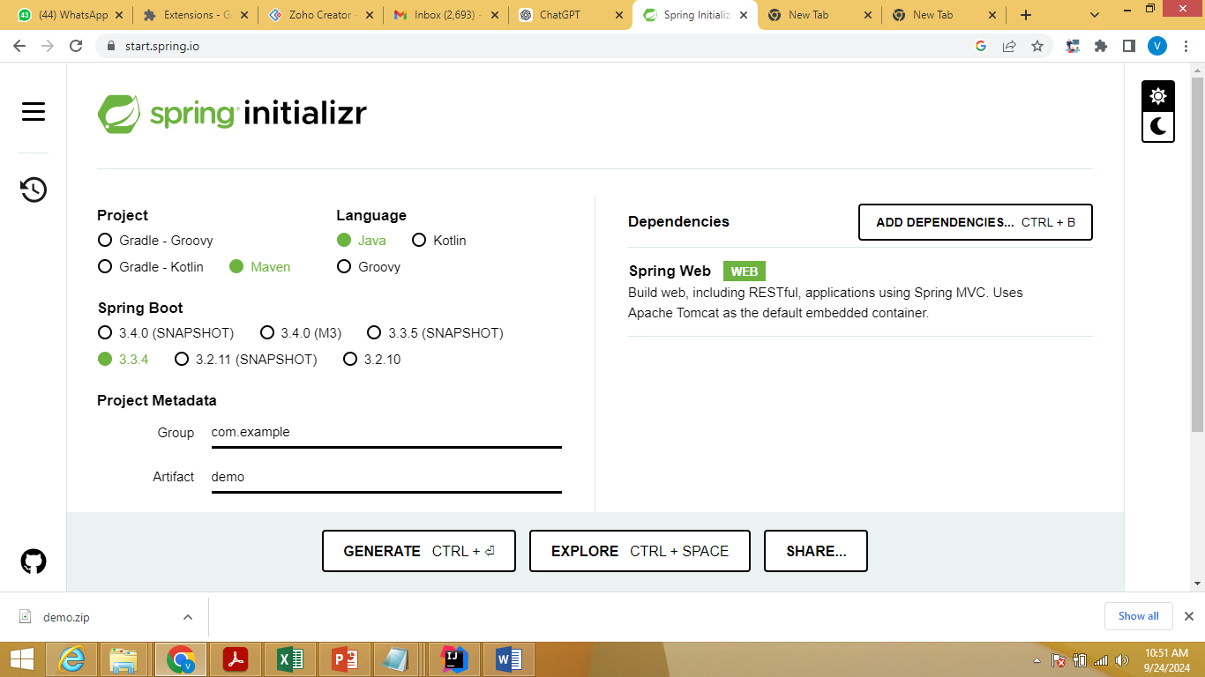

Slide 50
Give any example spring boot application for SpringIO topic.

Slide 51
RDBMS CRUD
In RDBMS (Relational Database Management System), CRUD operations represent the four basic functions that are essential for interacting with a database. These operations stand for Create, Read, Update, and Delete.
1. Create:The Create operation allows inserting new records into a table.
SQL Command:
INSERT INTOExample:sqlCopy codeINSERT INTO students (id, name, age) VALUES (1, 'John', 22);
2. Read:The Read operation retrieves records from a table.
SQL Command:
SELECTExample:sqlCopy codeSELECT * FROM students WHERE id = 1;
3. Update:The Update operation modifies existing records in a table.
SQL Command:
UPDATEExample:sqlCopy codeUPDATE students SET name = 'Jane' WHERE id = 1;
4. Delete:The Delete operation removes records from a table.
SQL Command:
DELETE FROMExample:sqlCopy codeDELETE FROM students WHERE id = 1;

Slide 52
How to use CRUD Operations In Springboot
To implement CRUD operations in Spring Boot with an HTML input/output page using Thymeleaf templates, and to configure application.properties for database connection, we can follow the steps listed below:
Step1: Set Up Your Spring Boot pom.xml
Use Spring Initializer or pom.xml to create a new Spring Boot project with the following dependencies:
Spring Web
Spring Data JPA
Thymeleaf
H2 Database (or any other database)

Slide 53
Step2: Configure application.properties
Define the database connection and JPA settings in the application.properties file located in the src/main/resources folder.
Set database connection properties (H2/MySQL/etc.).
Enable H2 console (if using H2).
Configure Hibernate dialect, DDL auto settings, etc.

Slide 54
Step3: Create an Entity Class
Define an entity class annotated with @Entity.
Add fields that represent table columns.
Use @Id and @GeneratedValue for the primary key.
Use getters and setters for the fields.

Slide 55
Step4: Create a Repository Interface
Create a repository interface by extending JpaRepository<EntityClass, ID>.
This interface will provide built-in methods for CRUD operations.

Slide 56
Step5: Create a Controller Class
Create a controller class annotated with @Controller.
Define methods mapped to HTTP endpoints (e.g., /create, /read, /update, /delete) using @GetMapping and @PostMapping.
Use Model and ModelAndView to pass data to Thymeleaf templates.
Handle form submissions (from the HTML input page) and return results (to the HTML output page).

Slide 57
Step 6:Create HTML Pages in src/main/resources/templates
Input Page: Create an HTML form (e.g., create.html) using Thymeleaf for accepting data input.The form should be connected to a controller method using th:action and th:object.
Output Page: Create an output page (e.g., output.html) to display the results or details of the data (such as listing records from the database).

Slide 58
Example :CRUD operations or DB based applications with Controller annotations
Needed files
Main class file
Entity class file
Repository interface file
Controller file (If needed, include service file)
-Pom.xml file
-Applictaion.properties file
-Html files

Slide 59
Example
Example to add student details (rollno, name) to the database

Slide 60
HTML files
“StudentList.html”
<html>
<head>
<meta charset="UTF-8">
<title>Student List</title>
</head>
<body>
<h1>Student List</h1>
<table border="1">
<tr>
<th>Roll No</th>
<th>Name</th>
</tr>
<tbody>
<tr th:each="student : ${students}">
<td th:text="${student.rollNo}"></td>
<td th:text="${student.name}"></td>
</tr>
</tbody>
</table>
<a href="/">Add More Students</a>
</body>
</html>
“StudentForm.html”
<html>
<head>
<meta charset="UTF-8">
<title>Add Student</title>
</head>
<body>
<h1>Add Student</h1>
<form action="/add" method="post">
<label for="name">Name:</label>
<input type="text" id="name" name="name" required>
<button type="submit">Add Student</button>
</form>
<a href="/list">View Students</a>
</body>
</html>

Slide 61
Pom.xml
<project xmlns="http://maven.apache.org/POM/4.0.0"
xmlns:xsi="http://www.w3.org/2001/XMLSchema-instance"
xsi:schemaLocation="http://maven.apache.org/POM/4.0.0
http://maven.apache.org/xsd/maven-4.0.0.xsd">
<modelVersion>4.0.0</modelVersion>
<groupId>com.example</groupId>
<artifactId>Welcomemessage</artifactId>
<version>1.0.0</version>
<packaging>jar</packaging>
<parent>
<groupId>org.springframework.boot</groupId>
<artifactId>spring-boot-starter-parent</artifactId>
<version>2.3.0.RELEASE</version>
<relativePath/>
</parent>
<dependencies>
<!-- Spring Boot Starter for Web -->
<dependency>
<groupId>org.springframework.boot</groupId>
<artifactId>spring-boot-starter-web</artifactId>
</dependency>
<!-- Spring Boot Starter for JPA -->
<dependency>
<groupId>org.springframework.boot</groupId>
<artifactId>spring-boot-starter-data-jpa</artifactId>
</dependency>
<!-- H2 Database -->
<dependency>
<groupId>com.h2database</groupId>
<artifactId>h2</artifactId>
<scope>runtime</scope>
</dependency>
<!-- Spring Boot Starter Test -->
<dependency>
<groupId>org.springframework.boot</groupId>
<artifactId>spring-boot-starter-test</artifactId>
<scope>test</scope>
</dependency>
<dependency>
<groupId>org.springframework.boot</groupId>
<artifactId>spring-boot-starter-thymeleaf</artifactId>
</dependency>
</dependencies>
<build>
<plugins>
<plugin>
<groupId>org.springframework.boot</groupId>
<artifactId>spring-boot-maven-plugin</artifactId>
</plugin>
</plugins>
</build>
</project>

Slide 62
Application.properties
spring.datasource.url=jdbc:h2:mem:testdb
spring.datasource.driverClassName=org.h2.Driver
spring.datasource.username=sa
spring.datasource.password=
spring.h2.console.enabled=true
spring.jpa.hibernate.ddl-auto=update

Slide 63
Main class
package com.example.studentmanagement;
import org.springframework.boot.SpringApplication;
import org.springframework.boot.autoconfigure.SpringBootApplication;
@SpringBootApplication
public class StudentManagementApplication {
public static void main(String[] args) {
SpringApplication.run(StudentManagementApplication.class, args);
}
}

Slide 64
Entity class
// Getters and Setters
public Long getRollNo() {
return rollNo;
}
public void setRollNo(Long rollNo) {
this.rollNo = rollNo;
}
public String getName() {
return name;
}
public void setName(String name) {
this.name = name;
}
}
package com.example.studentmanagement;
import javax.persistence.Entity;
import javax.persistence.GeneratedValue;
import javax.persistence.GenerationType;
import javax.persistence.Id;
@Entity
public class Student {
@Id
@GeneratedValue(strategy = GenerationType.IDENTITY)
private Long rollNo;
private String name;

Slide 65
Repository interface
package com.example.studentmanagement;
import org.springframework.data.jpa.repository.JpaRepository;
public interface StudentRepository extends JpaRepository<Student, Long> {
}

Slide 66
Controller class
package com.example.studentmanagement;
import org.springframework.beans.factory.annotation.Autowired;
import org.springframework.stereotype.Controller;
import org.springframework.ui.Model;
import org.springframework.web.bind.annotation.GetMapping;
import org.springframework.web.bind.annotation.PostMapping;
import org.springframework.web.bind.annotation.RequestParam;
import java.util.List;
@Controller
public class StudentController {
@Autowired
private StudentRepository studentRepository;
@GetMapping("/")
public String showForm(Model model) {
model.addAttribute("student", new Student());
return "studentForm";
}
@PostMapping("/add")
public String addStudent(@RequestParam String name, Model model) {
Student student = new Student();
student.setName(name);
studentRepository.save(student);
return "redirect:/list";
}
@GetMapping("/list")
public String listStudents(Model model) {
List<Student> students = studentRepository.findAll();
model.addAttribute("students", students);
return "studentList";
}
}

Slide 67
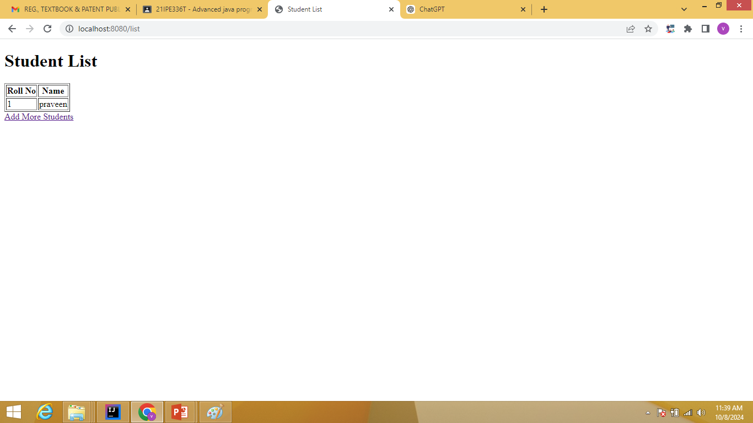

Slide 68
Postman
Postman is a powerful tool used for testing, developing, and interacting with REST APIs. It allows developers to easily send HTTP requests, examine responses, automate tests, and manage APIs during development.

Slide 69
Features of Postman in REST API
TestingBuilding and Sending Requests:Postman allows us to manually construct and send HTTP requests. We can specify the HTTP method (GET, POST, PUT, DELETE, etc.), the URL, headers, parameters, and body data (in formats like JSON, XML, etc.).
This helps in quickly testing various API endpoints to check if they’re functioning as expected.

Slide 70
When we are checking the RestAPI (First install the postman), we have to set the following fields
In Header tab
- Key should be “content-type”
- value should be “application/json”
In Body tab
- Choose “raw” data type and “json”

Slide 71
Example :CRUD operations or DB based applications with RestController annotations (or) REST API
Needed files
Main class file
Entity class file
Repository interface file
Controller file (If needed, include service file)
-Pom.xml file
-Applictaion.properties file

Slide 72
Pom.xml
<project xmlns="http://maven.apache.org/POM/4.0.0"
xmlns:xsi="http://www.w3.org/2001/XMLSchema-instance"
xsi:schemaLocation="http://maven.apache.org/POM/4.0.0
http://maven.apache.org/xsd/maven-4.0.0.xsd">
<modelVersion>4.0.0</modelVersion>
<groupId>com.example</groupId>
<artifactId>Welcomemessage</artifactId>
<version>1.0.0</version>
<packaging>jar</packaging>
<parent>
<groupId>org.springframework.boot</groupId>
<artifactId>spring-boot-starter-parent</artifactId>
<version>2.3.0.RELEASE</version>
<relativePath/>
</parent>
<dependencies>
<!-- Spring Boot Starter for Web -->
<dependency>
<groupId>org.springframework.boot</groupId>
<artifactId>spring-boot-starter-web</artifactId>
</dependency>
<!-- Spring Boot Starter for JPA -->
<dependency>
<groupId>org.springframework.boot</groupId>
<artifactId>spring-boot-starter-data-jpa</artifactId>
</dependency>
<!-- H2 Database -->
<dependency>
<groupId>com.h2database</groupId>
<artifactId>h2</artifactId>
<scope>runtime</scope>
</dependency>
<!-- Spring Boot Starter Test -->
<dependency>
<groupId>org.springframework.boot</groupId>
<artifactId>spring-boot-starter-test</artifactId>
<scope>test</scope>
</dependency>
<dependency>
<groupId>org.springframework.boot</groupId>
<artifactId>spring-boot-starter-thymeleaf</artifactId>
</dependency>
</dependencies>
<build>
<plugins>
<plugin>
<groupId>org.springframework.boot</groupId>
<artifactId>spring-boot-maven-plugin</artifactId>
</plugin>
</plugins>
</build>
</project>

Slide 73
Application.properties
spring.datasource.url=jdbc:h2:mem:testdb
spring.datasource.driverClassName=org.h2.Driver
spring.datasource.username=sa
spring.datasource.password=
spring.h2.console.enabled=true
spring.jpa.hibernate.ddl-auto=update

Slide 74
Main class
package com.example.studentmanagement;
import org.springframework.boot.SpringApplication;
import org.springframework.boot.autoconfigure.SpringBootApplication;
@SpringBootApplication
public class StudentManagementApplication {
public static void main(String[] args) {
SpringApplication.run(StudentManagementApplication.class, args);
}
}

Slide 75
Entity class
// Getters and Setters
public Long getRollNo() {
return rollNo;
}
public void setRollNo(Long rollNo) {
this.rollNo = rollNo;
}
public String getName() {
return name;
}
public void setName(String name) {
this.name = name;
}
}
package com.example.studentmanagement;
import javax.persistence.Entity;
import javax.persistence.GeneratedValue;
import javax.persistence.GenerationType;
import javax.persistence.Id;
@Entity
public class Student {
@Id
@GeneratedValue(strategy = GenerationType.IDENTITY)
private Long rollNo;
private String name;

Slide 76
Repository interface
package com.example.studentmanagement;
import org.springframework.data.jpa.repository.JpaRepository;
public interface StudentRepository extends JpaRepository<Student, Long> {
}

Slide 77
Controller class
package com.example.studentmanagement;
import org.springframework.beans.factory.annotation.Autowired;
import org.springframework.stereotype.Controller;
import org.springframework.ui.Model;
import org.springframework.web.bind.annotation.GetMapping;
import org.springframework.web.bind.annotation.PostMapping;
import org.springframework.web.bind.annotation.RequestParam;
import java.util.List;
@RestController
@RequestMapping("/students")
public class StudentController {
@Autowired
private StudentRepository studentRepository;
// Add a new student
@PostMapping("/add")
public Student addStudent(@RequestBody Student student) { return studentRepository.save(student); }
// Get all students
@GetMapping("/list")
public List<Student> getStudents() { return studentRepository.findAll(); }
}

Slide 78
